Slide 1
Trusted Tester
Awareness Course
Presenter: TBD | Date TBD
Notes:
INSTRUCTIONS: Launch Adobe Connect at least 30 minutes before the start of the webinar to make sure there are no technical issues.
Conduct a sound/technical issues check.
Ask participants to confirm whether they can hear you by replying through the Chat pod.
Tell participants to use the Chat pod to report any technical issues they experience during the webinar.
SPEAKER: Welcome to the Trusted Tester Awareness Webinar. I am XXXX, and I will be your host for today’s session.

Slide 2
GOAL: To provide an overview of the purpose, benefits, and components of the Trusted Tester certification program.
Notes:
SPEAKER: During this webinar we will explore the Trusted Tester certification program. You will get an overview of the program’s purpose, benefits, and components. This Webinar will last for approximately 30 minutes.

Slide 3
Webinar Logistics
Technical Support:
Report technical issues via the Chat tool.
Adobe Connect Technical Support
Adobe Connect Visual Quick Start Guide for Participants
Tutorials: https://forums.adobe.com/docs/DOC-6942#jive_content_id_Connect_Tutorials
Adobe Connect Overview
Notes:
SPEAKER: MODIFY FOR CURRENT PLATFORM. We are now going to take a moment to get familiar with the basic functions of Adobe Connect. Point out the following interface features:
Attendees Pod – This pod lists attendees by role. A microphone icon to the right of the attendee’s name indicates who is speaking. To start a private chat, hover over an attendee’s name.
Chat Pod – Use this pod to send a message to everyone or an individual. Initially, you will only notice a chat labeled “Everyone.” As you add additional chats, they will appear to the right of the “Everyone” chat.
SPEAKER: If you experience any technical issues during the session, please report it through the Chat pod. Or call Adobe Connect Support at 866-229-3239 get help to resolve issues with the software. For more information about using the software, refer to the Adobe Connect Visual Quick Start Guide for Participants or visit https://forums.adobe.com/docs/DOC-6942#jive_content_id_Connect_Tutorials.
NOTE TO MODERATOR: Copy and paste the Adobe Connect technical support number and tutorial Web site in the Chat pod.

Slide 4
Participation Guidelines
Participate
Mute your phone when you are not speaking
Do not put your phone on hold
Raise your hand to ask a question
Identify yourself when speaking
Notes:
SPEAKER: We encourage you to participate, ask questions and share your experiences. Please keep your phones on mute when you are not speaking.
[Provide instructions on how to mute the phone via the conference line.]
Do not put your phones on hold at any time during the webinar. If you have to take another call or a break, hang up and call back to rejoin.
Some of you may be in a setting where you cannot speak aloud, such as in a cubicle, but we still encourage you to participate through the Chat pod.
When I say “raise your hand,” I mean for you to raise your hand in Adobe Connect by selecting the Hand Raise icon.

Slide 5
Today’s Agenda
Introductions
Webinar Objectives
Trusted Tester Program Purpose
Role of the Trusted Tester
Components of the Trusted Tester Review
Trusted Tester Curriculum and Requirements
Webinar Wrap Up
Notes:
INSTRUCTIONS: Review the webinar agenda by reviewing the items on the slide.
SPEAKER: After introductions and a review of the Webinar objectives, we will discuss:
Trusted Tester Program Purpose
Role of the Trusted Tester
Components of the Trusted Tester Review
Trusted Tester Curriculum and Requirements
The session will wrap up with us sharing the key takeaways we got from the session.

Slide 6
Participant Introductions
Share your:
Name
Title/Job Description
Agency
Webinar Expectations
Notes:
INSTRUCTION: Share this information about yourself: The agency for which you work, your job title, a brief description of your responsibilities with regards to procurement and acquisition. Provide your contact information in the Chat pod.
SPEAKER: Let’s take a few minutes to get to know each other. I am XXX…
Please share your name, title/job description, and agency, along with your expectations for the Webinar.

Slide 7
Objectives
Describe the:
Purpose of the Trusted Tester Program
Role and Function of Trusted Testers
Components of a Trusted Tester Review
Requirements for Trusted Tester Certification
Notes:
INSTRUCTIONS: Review the webinar objectives by reviewing the bullets on the slide.
SPEAKER: Let’s review the main objectives for this Webinar. At the end of this session, you should be able to:
Describe the role and function of Trusted Testers in ensuring that ICT is accessible for all
Identify major components of a Trusted Tester review.
Identify the of curriculum and requirements for successful completion of the Trusted Tester Certification program.

Slide 8

Trusted Tester Program Purpose

Slide 9
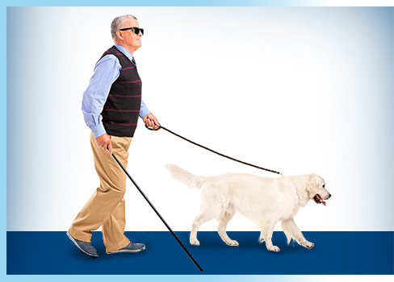
Section 508 Accessibility Standards
What is Section 508?
A law and set of standards that requires Federal agencies to make Information and Communication Technology (ICT) accessible to individuals with disabilities.
Applies to ICT that is procured, developed, maintained, or used by agencies of the Federal government.
Section 508 was enacted to eliminate barriers to ICT, make opportunities available for persons with disabilities, and encourage development of technologies that will help achieve these goals.
Notes:
SPEAKER: Let’s begin with a review of what Section 508 is and why it mattters.
Section 508 of the Rehabilitation Act of 1973 as amended is a law and set of standards that requires Federal agencies to make ICT accessible to employees and members of the public who have disabilities in a comparable manner to the access experienced by employees and members of the public without disabilities.
The revised Section 508 Standards apply to ICT that is "procured, developed, maintained, or used" by agencies of the Federal government. Section 508 was enacted to eliminate barriers to ICT, make opportunities available for persons with disabilities, and encourage development of technologies that will help achieve these goals.

Slide 10

Why Accessibility Matters
Accessibility Is Everyone’s Responsibility
Citizens rely on their government for a range of essential services.
Federal employees require equal access to technology to successfully perform their jobs.
When equal access to information is not afforded to individuals with disabilities, those people may be excluded from essential information, services, or opportunities that should be available to all Americans.
Notes:
SPEAKER: Why is it important that we ensure our products are accessible?
According to the US Census Bureau, about 56.7 million people — or 19 percent of the US population — had a disability in 2010. That is a huge percentage of the public that we serve. Citizens rely on the government for a range of essential services that impact their well-being, such as medicare/medicaid/social security support, assistance in finding low-income housing, and veteran’s support services from the VA, etc. Federal employees require access to technology to perform their jobs successfully and have career advancement opportunities afforded to other employees.
When this information is presented in a way that is not accessible to people with disabilities, those people are shut out from essential services and opportunities that should be available to all Americans. Additionally, a large number of Americans with disabilities are employed by the federal government, and having accessible technology is essential for them to be able to perform their work effectively.

Slide 11
Benefits of Conformance
Eliminates barriers to ICT
Provides equal opportunities
Encourages new technologies
Provides standards for accessibility
Complies with the law
Notes:
SPEAKER:
Complying with the Section 508 Standards provides an agency numerous benefits. Section 508 conformance:
Eliminates barriers to ICT - We are in an increasingly complex world so eliminating barriers become more important.
Provides equal opportunities to persons with disabilities - Technology is increasingly important for full participation in society.
Encourages development of technologies that enable these goals
Provides standards for how accessibility can be achieved
And finally, accessibility is the law of the land. All federal employees and contractors who produce ICT products or services for the federal government have a responsibility to make sure persons with disabilities are able to access and use the ICT they develop.

Slide 12
Origins of the Trusted Tester Program
Developing a Consistent, Repeatable Process
USCIS/DHS developed test checklist and repeatable test process to train IT testers in the federal space.
Other agencies recognized the benefit of a standardized testing process.
DHS developed program to certify testers for accessibility in the federal space and opens the course at no cost to the program participant.
DHS worked with Access Board to revise the test process to align with WCAG 2.0 and the Revised Section 508 Standards.
Notes:
SPEAKER: Following the establishment of Section 508, USCIS and DHS recognized a need to train IT testers on accessibility conformance and worked together to develop a test checklist and repeatable test process. Soon, other federal agencies started to recognize the benefit of a standardized testing process.
DHS developed program to certify testers for accessibility in the federal space and opens the course at no cost to the program participant. DHS then worked with Access Board to revise the test process to align with WCAG. Finally, the Trusted Tester program was born to certify testers for accessibility in the federal space and opens the course free of charge to the general public.

Slide 13
Trusted Tester Purpose
Manual test approach that aligns with the Revised Section 508 Standards and the ICT Testing Baseline requirements.
Provides repeatable, shareable, and reliable conformance test results.
Agencies that adopt the Trusted Tester Process only accept test results from individuals who have been certified as Trusted Testers.
The current version of Trusted Tester is only used to evaluate websites and web applications. It cannot be used for non-web software or documents.
Notes:
SPEAKER:The Trusted Tester Process is a manual test approach that aligns with the Revised Section 508 Standards and the ICT Testing Baseline requirements. It provides repeatable, shareable, and reliable conformance test results.
Agencies that adopt the Trusted Tester Process only accept test results from individuals who have been certified as Trusted Testers. The Trusted Tester process is currently only used to evaluate websites and web applications. It cannot be used for non-web software or documents.

Slide 14

Trusted Tester Role

Slide 15

What is a Trusted Tester?
Person certified to:
Provide accurate and repeatable test results.
Follow the Trusted Tester Process to evaluate web content for conformance with Revised Section 508 standards.
Use approved, standardized testing tools. This standardized process is used to ensure that the accessibility testing is done the same way every time.
Notes:
SPEAKER: A Trusted Tester is a person who has passed the Trusted Tester Certification Exam and is certified to provide accurate and repeatable Revised 508 conformance test results for web content. A Trusted Tester follows the Revised Section 508 Conformance Test Process for Web, uses approved testing tools, and evaluates web content for conformance with Revised 508 standards.

Slide 16
Who Should Become a Trusted Tester?
Trusted Testers may perform the role as part of their job or may be a dedicated tester based on organization’s volume of development and needs.
Team members that make great Trusted Testers include:
Section 508 Program Managers
Web content managers
IT testing professionals
Developers and other members of the development team
But remember, anyone who wants to can become a Trusted Tester!
Notes:
SPEAKER: Some agencies may have dedicated Trusted Testers, while others may have team members who become Trusted Testers as part of their job. The number of Trusted Testers within an agency or organization varies based on the organization’s volume of development and needs.
Anyone can become a Trusted Tester, but people that work within the development or accessibilty areas of an agency have responsibilities that lend themselves to performing the job, such as content developers, testing professionals, developers, and Section 508 program managers.

Slide 17

Benefits of Using a Trusted Tester
How Will it Help My Agency?
Promotes a common understanding of the Section 508 Standards.
Unifies the test process, tools, and reporting.
Allows test results to be shared.
Integrates Section 508 into the development and acquisition lifecycle.
Improves ability for developers to reproduce test results which expedites remediation of non-conforming content.
Notes:
SPEAKER: Using a Trusted Tester process can benefit an agency in many ways. It:
Promotes a common understanding of the 508 standards.
Unifies the test process, tools, and reporting.
Allows test results to be shared.
Integrates Section 508 into the development and acquisition lifecycle.
Improves ability for developers to reproduce test results which expedites remediation of nonconforming content.

Slide 18
Benefits of Becoming a Trusted Tester
What’s in it for Me?
Trusted Testers have a marketable skill that makes them more employable in the IT development community.
Trusted Testers have a greater understanding of accessibility requirements and provide valuable insight to agencies in meeting accessibility requirements.
Trusted Testers help their agencies produce higher quality products and help all users gain equitable access to information and digital services.
While there is a time investment, the certification program is available online to anyone at no cost.
Notes:
SPEAKER: Becoming a Trusted Tester also offers many benefits to persons who complete the program. Trusted Testers can develop a marketable skill that can make them more employable in their agency or in the accessiblity community. They can provide valuable insight to agencies in meeting accessibility requirements. This can help the agency develop quality accessible products and keep them in compliance with the law. And remember, while there is a time investment, the certification program is available online to anyone free of charge.

Slide 19

Components of the Trusted Tester Review

Slide 20
ICT Baseline v Trusted Tester
What’s the Difference?
ICT Baseline
Describes how to evaluate conformance to the Revised Section 508 Standards.
Establishes the minimum tests that determine whether Web content meets requirements.
Not a test process but is used to create one.
Tool agnostic.
Trusted Tester
Formal process aligned to the ICT baseline that details how to test and what tools to use.
Provides a required test sequence and tools.
Reduces ambiguity, increases consistency of results, and emphasizes methods that meet Section 508 ICT Accessibility requirements.
Notes:
SPEAKER: Let’s look now at the components of a Trusted Tester Review.
The ICT baseline is the basis for the Trusted Tester process. It describes how to evaluate conformance to the Revised 508 Standards, which align with WCAG 2.0 Level A and AA Success Criteria. It is organized by categories to help you easily identify applicable requirements.
The ICT Baseline establishes the minimum tests and evaluation guidance that determine whether Web content meets Section 508 requirements. (which are also minimum standards). The Baseline is not a test process and does not include testing tools; rather, it is used to create an accessibility test process.
Test processes aligned to the baseline will produce the same baseline test results and will provide consistency across government and confidence in test results shared between agencies.
The Trusted Tester process was developed based on the ICT Baseline. It tells us how to conduct the test and what tools to use. Using the Trusted Tester process reduces ambiguity, increases consistency of results, and emphasizes methods that meet Section 508 ICT Accessibility requirements.

Slide 21
Section 508 Conformance Tests
Examples
Conformance tests look for accessibility issues such as:
Keyboard access - All functionality of the content is operable through a keyboard interface.
Repetitive content - A mechanism is available to bypass (or skip) content that is repeated on multiple pages.
Images - All non-text content that is presented to the user has an equivalent text alternative.
Contrast - Visual presentation of text and images of text has a sufficient contrast ratio for people with low vision.
Links - Purpose of each link can be determined from the link text alone or from the link text together with its programmatically determined link context.
Notes:
SPEAKER: There are a total of 20 Section 508 conformance tests in the Trusted Tester program. Examples of some of those tests are are shown here.

Slide 22

Testing Practices
Trusted Tester is a manual process.
Most accessibility requirements necessitate manual inspection because they require human judgment to determine if conformance is met.
Automated tools can be an important part of development and help quickly identify common errors and accessibility issues, but tools have limitations.
If you use automated tools, they must be augmented by manual testing.
Notes:
SPEAKER:Trusted Tester is a manual process. Most accessibility requirements necessitate manual inspection because they require human judgment to determine if conformance is met.
Automated tools can be an important part of development and help quickly identify common errors and accessibility issues, but tools have limitations. Automated testing generally doesn't allow you to fully determine compliance with the laws. For example, these tools can test for the presence of alternative text but not if the text is a meaningful alternative. You can use automated testing tools to augment validation efforts; however, by themselves automated tools can only provide partial coverage of the Section 508 Standards. If you use automated tools, they must be augmented by manual testing.

Slide 23
Testing Tools
Trusted Tester uses two tools – ANDI and the Colour Contrast Analyser – to help facilitate the testing process.
These tools were selected based on several factors including ease of use, ease of teaching, and accuracy of results.
The tools are free to install and use.
They assist the tester with verification of accessibility properties and reduce the need for a tester to view source code or have in-depth knowledge of programming languages.
Notes:
SPEAKER: Trusted Tester uses two tools – ANDI and the Colour Contrast Analyser – to help facilitate the testing process. These tools were selected based on several factors including ease of use, ease of teaching, and accuracy of results. The tools are available on the Web and are free to install and use. They assist the tester with verification of accessibility properties and reduce the need for a tester to view source code or have in-depth knowledge of programming languages.

Slide 24
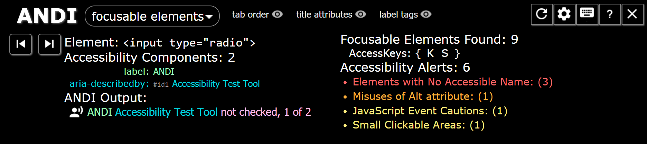
Accessible Name and Description Inspector (ANDI)
Semi-automated Code Inspection
Developed by the Social Security Administration.
Reveals what a screen reader should say for interactive elements.
Gives practical suggestions to improve accessibility and check 508 compliance.
Notes:
SPEAKER: One of the tools used in the Trusted Tester process is the Accessible Name and Description Inspector (ANDI).
ANDI was developed by the Social Security Administration and is designed to test web content for accessibility. As opposed to an automated tool, ANDI does not provide a report of accessibility issues. Instead, it identifies the parts of the code that a tester needs to evaluate to determine whether page elements are accesible. ANDI does not scan an entire site; instead it identifies parts of the code on a single page.
It is free and simple to use. It requires a plug in installation then can be used by navigating to a site to test and opening the bookmarked tool.

Slide 25
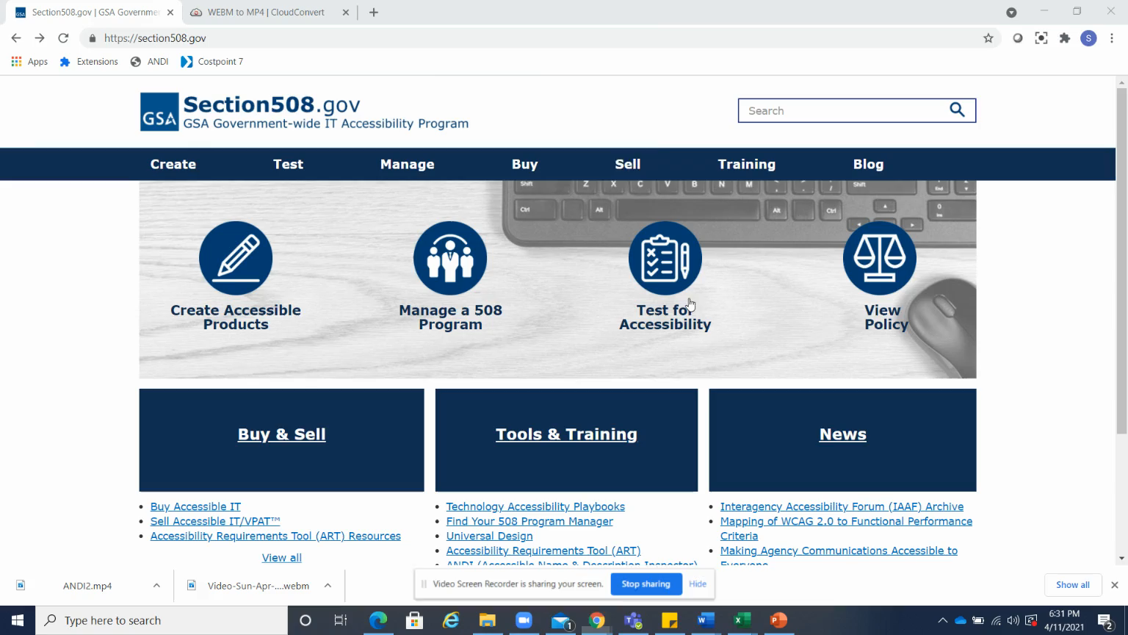
ANDI Demonstration
Semi-automated Code Inspection
Extended description of animation is located in the speaker notes.
Notes:
SPEAKER: In this brief video animation, you can see a demonstration of how simple ANDI is to use. Simply navigate to the page to be tested and select the ANDI bookmark. ANDI will begin its scan. Use the drop down list on the top left corner of the screen to select the ANDI module you want to use. ANDI will scan the page for items in that module (focusable elements, graphics, etc.). You can then use the arrows to scroll through those items. ANDI highlights the item in focus on the page and then displays the scanned attributes for that item. You can also review information about all items in the selected ANDI module on the right side of the screen, such as total number of links found on the page. Any alerts or conformance issues (for example, missing alt text) will also display here.

Slide 26
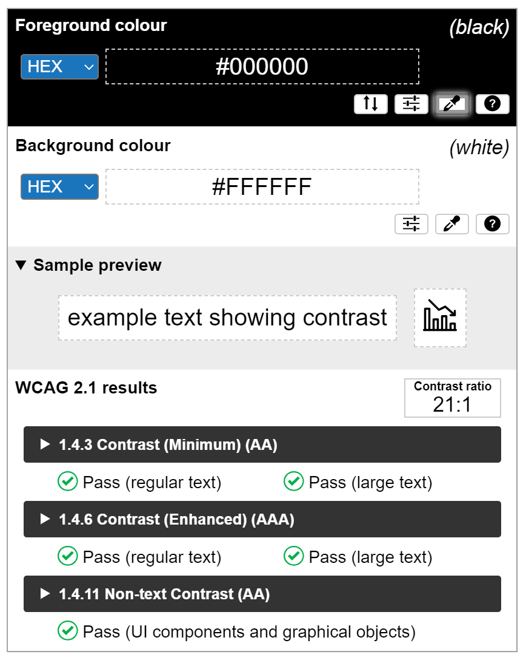
Colour Contrast Analyser (CCA)
Free color contrast checker tool that allows you to easily determine the contrast ratio of two colors simply using an eyedrop tool.
Enables you to optimize content–including text and visual elements–for individuals with vision disabilities.
Used to inspect color contrast when contrast cannot be programmatically identified by ANDI.
Notes:
SPEAKER: The Colour Contrast Analyser (CCA) is a free color contrast checker tool that allows you to easily determine the contrast ratio of two colors simply using an eyedrop tool.
The CCA enables you to optimize your content–including text and visual elements–for individuals with vision disabilities like color-blindness and low-vision impairments.

Slide 27
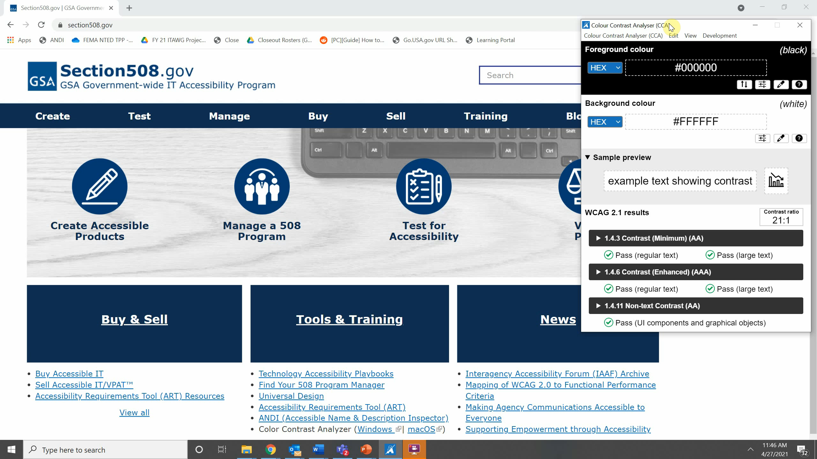
CCA Demonstration
Extended description of animation is located in the speaker notes.
Notes:
SPEAKER: This brief video animation provides a demonstration of how the CCA works. To start, open the webpage, application, or file you wish to check, then open the CCA tool. In this demonstration, we have used a webpage. To check the color contrast, select the Foreground color eye drop tool, move your cursor over the text color and select enter. Then perform the same function for the background color. After the foreground and background colors have been identified, the contrast ration displays in the Results area, which also indicates whether the contrast ratio passes or fails.

Slide 28

Accessibility Conformance Report Tool (ACRT)
Standalone browser-based application used to track accessibility test results.
Developed specifically to provide results against the Trusted Tester test IDs.
Provides the ability to report test results for conformance to the Revised Section 508 Standards and generates an easy-to-read report.
Notes:
SPEAKER: The Accessibility Conformance Report Tool (ACRT) is a Standalone browser-based application used to track findings from the Trusted Tester review process. It provides the ability to report test results for conformance to the Revised Section 508 Standards and generates an easy-to-read report.

Slide 29

Trusted Tester Curriculum and Requirements

Slide 30
Trusted Tester Program Curriculum
FACA-ALL-049-B
DHSA-TT-100-A
DHSA-TT-150-A
DHSA-TT-200-A
DHSA-TT-201-A
DHSA-TT-202-A
Notes:
SPEAKER: Now let’s look at the requirements to obtain a Trusted Tester certification.
The Trusted Tester Training Track provides a path to earn the Trusted Tester certification for web on the windows platform. There are a total six web-based courses in the program. Students will learn about the Section 508 Standards applicable to the web, how to install and use web accessibility test tools, and how to apply the Trusted Tester process for testing web sites and web applications for conformance to the Revised Section 508 standards.

Slide 31
FACA-ALL-049-B
FACA-ALL-049-B
DHSA-TT-100-A
DHSA-TT-150-A
DHSA-TT-200-A
DHSA-TT-201-A
DHSA-TT-202-A
FACA-ALL-049B
What is Section 508 and Why is It Important?
Course Purpose: Web-based course introducing Section 508 is and why it is important to make accessible products ICT. This course serves as a prerequisite to all other Section 508 compliance training courses.
Course Duration: 10+ hours
Notes:
SPEAKER:
FACA-ALL-049B
What is Section 508 and Why is It Important?
This course is designed to describe what Section 508 is and why it is important to make Information and Communication Technology (ICT) products accessible to people with disabilities. In this course, students learn about the job-related responsibilities, and available resources needed to meet Section 508 requirements. This course serves as a prerequisite to all other Section 508 compliance training courses. It is a 10-hour web-based course.

Slide 32
DHSA-TT-100-A
FACA-ALL-049-B
DHSA-TT-100-A
DHSA-TT-150-A
DHSA-TT-200-A
DHSA-TT-201-A
DHSA-TT-202-A
DHSA-TT-100-A
Section 508 Standards for Web
Course Purpose: Web-based course providing a basic understanding of the Section 508 standards for web and web applications. This course is a prerequisite for anyone planning to certify as a Trusted Tester.
Course Duration: 20+ hours
Notes:
SPEAKER:
DHSA-TT-100-A
Section 508 Standards for Web
This 20-hour web-based course is designed for personnel who need a basic understanding of the Section 508 standards for web and web applications. It is also the prerequisite for becoming a Trusted Tester. Students will learn about a subsection of those technical standards; those that deal with the compliance of web sites and web applications. This course is a prerequisite for Trusted Tester Training, for any students who plan to certify as DHS Section 508 Trusted Testers

Slide 33
DHSA-TT-150-A
FACA-ALL-049-B
DHSA-TT-100-A
DHSA-TT-150-A
DHSA-TT-200-A
DHSA-TT-201-A
DHSA-TT-202-A
DHSA-TT-150-A
Trusted Tester Tools for Web on Windows
Course Purpose: In this web-based course, students will install and begin to learn about the required software used for testing web sites for Section 508 conformance, including system requirements and recommended workstation configurations.
Course Duration: 5+ hours
Notes:
SPEAKER:
DHSA-TT-150-A
Trusted Tester Tools for Web on Windows
This course is designed to enable students to install or coordinate the installation of the required software used for testing web sites and web applications for Section 508 conformance, and to validate that the newly installed tools are working correctly. As part of this course, students are required to review the downloadable Installation Guide that provides minimum systems requirements as well as recommended workstation configurations for 508 testing.

Slide 34
DHSA-TT-200-A
FACA-ALL-049-B
DHSA-TT-100-A
DHSA-TT-150-A
DHSA-TT-200-A
DHSA-TT-201-A
DHSA-TT-202-A
DHSA-TT-200-A
Section 508 Standards for Web
Course Purpose: Web-based course teaching the Trusted Tester process and associated tools for testing websites and for compliance with Section 508 standards.
Course Duration: 20+ hours
Notes:
SPEAKER:
DHSA-TT-200-A
Section 508 Standards for Web
This 20-hour web-based course teaches the Trusted Tester process for testing websites and web applications for compliance with Section 508 standards. Students learn and apply the processes for testing both web and web applications for Section 508 compliance. They also learn which tools are needed to perform this testing and how to use those tools. Upon completion of this course, they will be able to identify the tools and procedures, for the process for testing web and software applications for Section 508 compliance, and apply test processes to evaluate elements of web site sites and web applications for Section 508 compliance. Following successful completion of this course, students will qualify to proceed to the Section 508 Trusted Tester Certificate Exam.

Slide 35
DHSA-TT-201-A
FACA-ALL-049-B
DHSA-TT-100-A
DHSA-TT-150-A
DHSA-TT-200-A
DHSA-TT-201-A
DHSA-TT-202-A
DHSA-TT-201-A
Practice Exam for Web on Windows
Course Purpose: In this web-based practice exam, students will perform 508 compliance testing using the test process, determining appropriate methods for web content and entering results of their evaluation for scoring.
Course Duration: 20+ hours
Notes:
SPEAKER:
DHSA-TT-201-A
Practice Exam for Web on Windows
This 20-hour web-based practice exam provides hands-on testing of a multi-page application for Section 508 compliance using the DHS Section 508 Compliance Test Process for Applications. Students will perform 508 compliance testing using the test process, determining appropriate methods for web content and entering results of their evaluation for scoring. NOTE! Students must score a 90 or better on the Practice Exam to be eligible to proceed to the Trusted Tester - Certification Exam.

Slide 36
DHSA-TT-202-A
FACA-ALL-049-B
DHSA-TT-100-A
DHSA-TT-150-A
DHSA-TT-200-A
DHSA-TT-201-A
DHSA-TT-202-A
DHSA-TT-202-A
Trusted Tester Certification Exam for Web on Windows
Course Purpose: The web-based exam involves testing a multi-page application for Section 508 compliance using the DHS Section 508 Compliance Test Process. Certificate award is based on accurate reporting of compliance issues.
Course Duration: 10+ hours
Notes:
SPEAKER:
DHSA-TT-202-A
Trusted Tester Certification Exam for Web on Windows
This 10-hour exam provides hands-on testing of a multi-page application for Section 508 compliance using the DHS Section 508 Compliance Test Process for Applications. Students will perform 508 compliance testing using the test process, determining appropriate methods for web content and entering results of their evaluation for scoring.
Trusted Tester Certification will be based upon an assessment of accurate reporting of 508 compliance issues using the DHS Section 508 Compliance Test Process for web sites and web applications.

Slide 37

Certification Requirements
Students must complete all courses and score 90% or better on the final exam.
Practice exam allows unlimited attempts before taking the final exam.
Final exam allows 2 attempts (one attempt, one retake.)
Further attempts require coordination with DHS.
Check with DHS on completion timeline requirements, as these may change.
Notes:
SPEAKER:
In order to obtain a Trusted Tester certification, students must complete all courses and score at least a 90% on the final exam. Studenst will be allowed two attempts to pass the exam. For students who do not pass the test on the second attempt, DHS will develop a customized plan based on that student’s performance. This may include retaking some courses and taking incremental exams and practice exams.
There are timeline constraints for completing the program once you begin. Check with DHS for more information about those requirements.

Slide 38
Webinar Wrap-Up

Slide 39

Webinar Wrap-up
Closing Remarks
Thank you for coming!
Remember – accessibility is everyone’s responsibility.
For enrollment and Trusted Tester program questions, visit Training.Section508testing.net.
For questions about this training and other Section 508 resources, visit Section508.gov.
Notes:
INSTRUCTIONS: Thank participants for attending the webinar, wish them well in applying all they have learned to their work duties, and remind them to visit Training.Section508testing.net for Trusted Tester quesitons or Section508.gov for questions about other Section 508 training.

